Slide 1

The 2016
William S. Gulick
Project Excellence Award

Slide 2

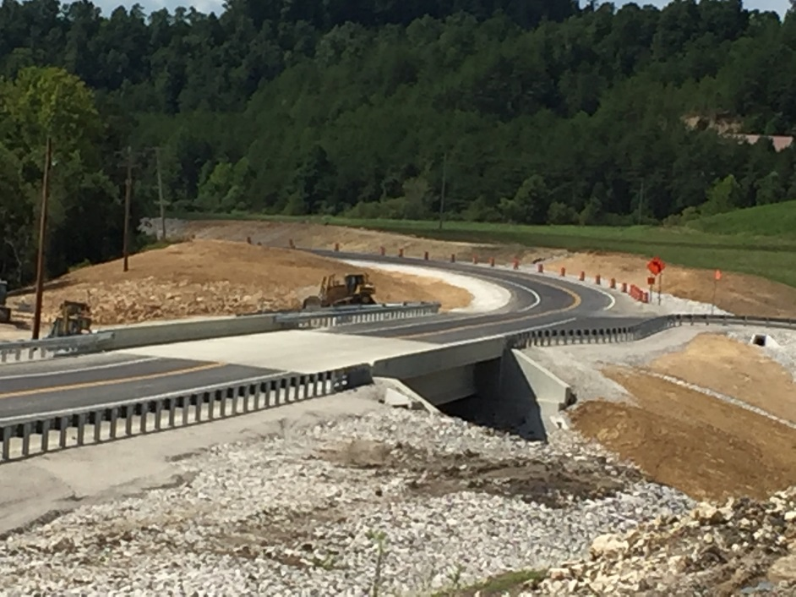
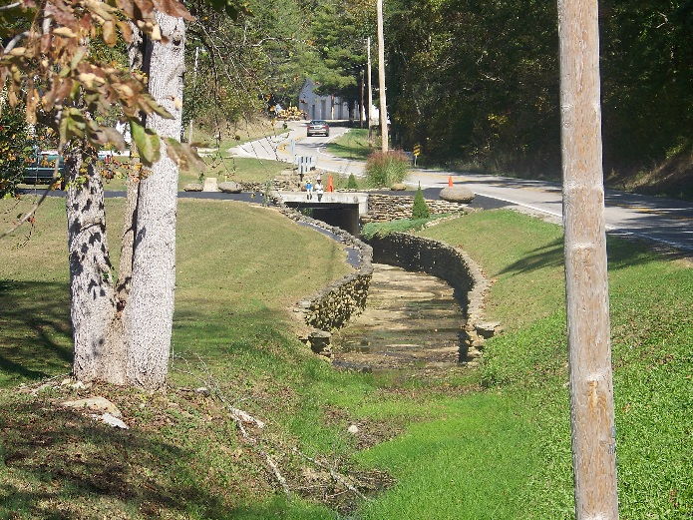
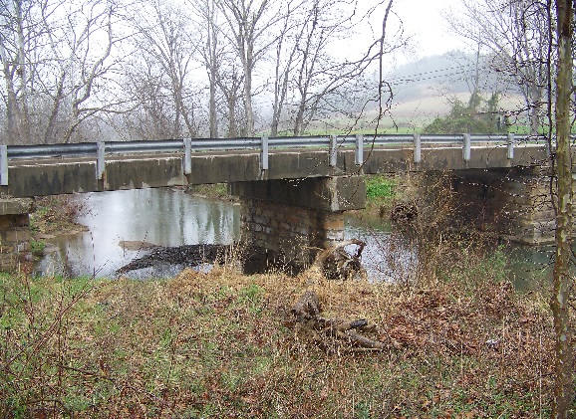
KY 30 TRAVELLERS REST
RECONSTRUCTION PROJECT
district 10
design section

Slide 3
PROJECT
TYPICAL SECTION
DESIGN CRITERIA | EXISTING | FINAL
# OF LANE | 2 | 2
PAVE WIDTH | 20’ | 22’
SHLD WIDTH | 1’ | 10’
BRIDGE WIDTH | 20’ | 42’
MIN. RADIUS | 159.2’ | 965’
MAX. GRADE | 5.2% | 5%
MIN. SIGHT D. | 200’ | 495’

Slide 4
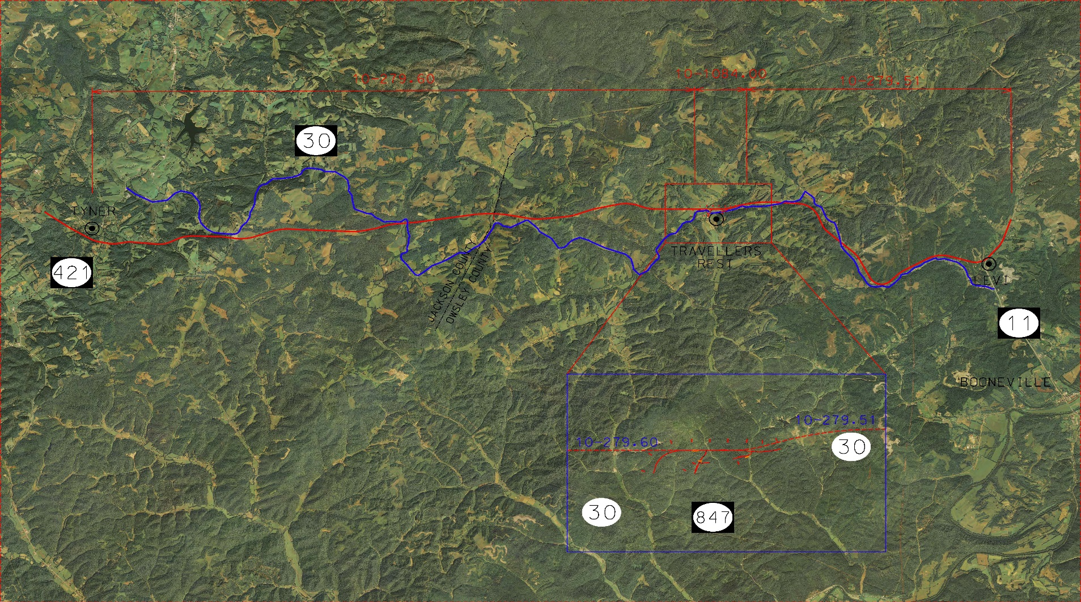
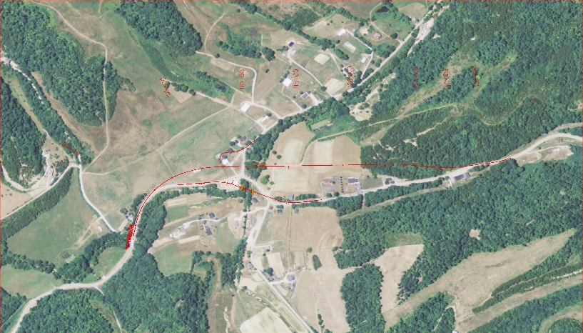
Interstate 75- Mountain Parkway Corridor
KY 30 Sections, 10-279.60, 10-1084, and 10-279.51
10-1084.00
10-279.60
10-1084.00
10-279.51
EXISTING
ALIGNMENT
TYLER
TRAVELLERS
REST
PROPOSED
ALIGNMENT
LEVI
JACKSON COUNTY
OWSLEY COUNTY
10-1084
Selected
ALTERNATE 1
BOONEVILLE
10-279.51
10-279.60
ALTERNATE 2

Slide 5
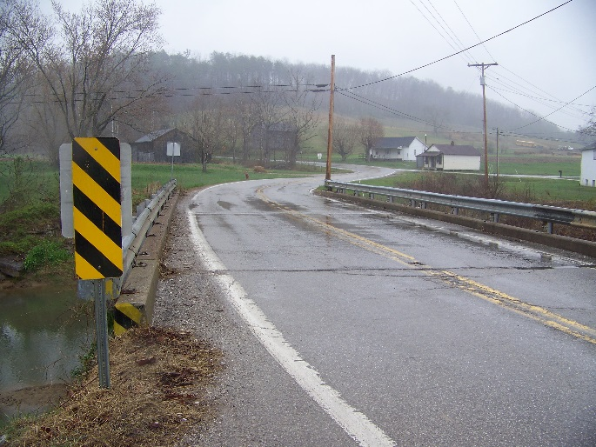
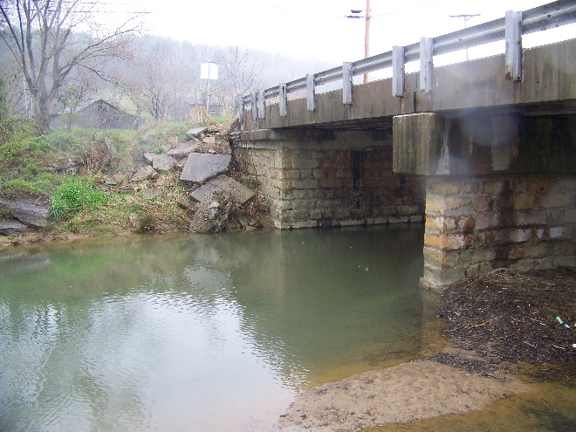
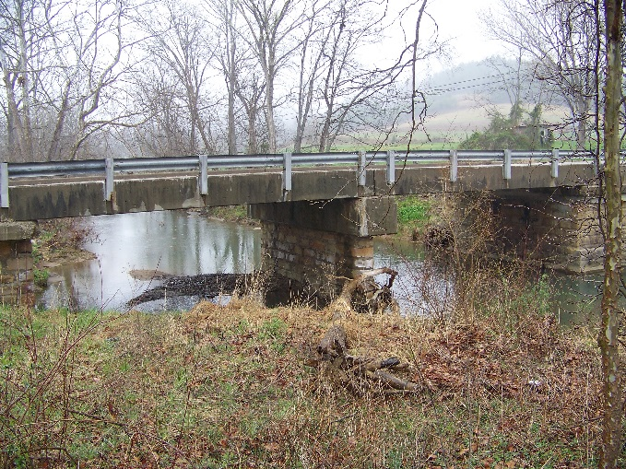
EXISTING CONDITIONS
10-1084.00
Existing bridge with structural rating of 8.3
Poor horizontal and vertical alignments at bridge approaches.
Debris pile up at the center pier.
If replaced at current location, would not be used with new KY 30 corridor

Slide 6
PROJECT Considerations
10-1084.00
10-1084: Originally a bridge replacement project
During Preliminary Line and Grade Project team evaluated and discussed the London (Interstate 75)- Mountain Parkway Corridor reconstruction and this project lays within the proposed corridor.
10-1084 falls between two KY 30 reconstruction projects that’s part of the London – Mountain Parkway Corridor, 10-279.51 and 10-279.60.
Project team decided to go with the alternate that can be tied into the proposed London-Mountain Parkway corridor.
10-279.51: Reconstruction of KY 30 from Travellers Rest to Levi. Currently under construction
10-279.60: Reconstruction of KY 30 from Tyler to Travellers Rest. The Owsley County section (10-279.61) moving to phase 2.

Slide 7
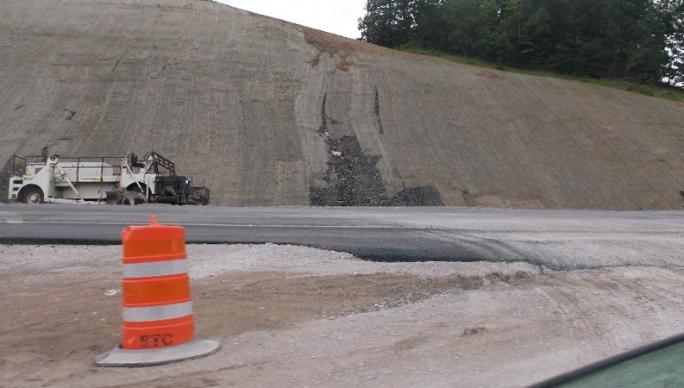
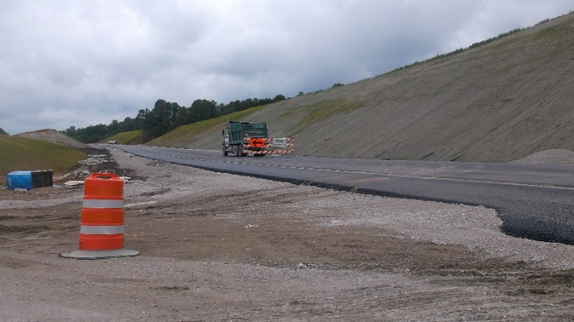

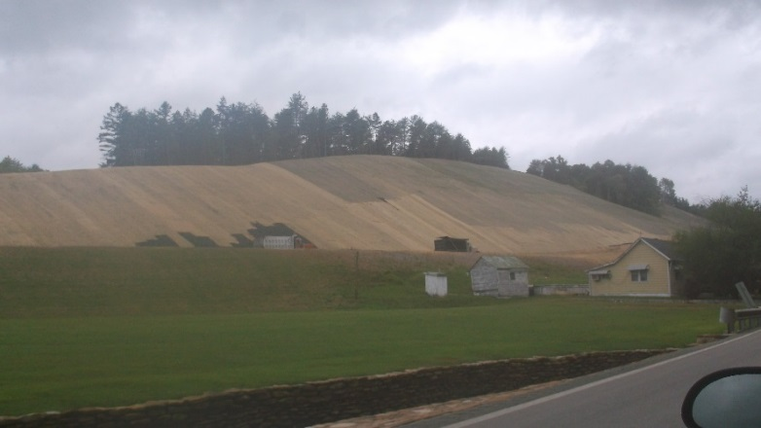
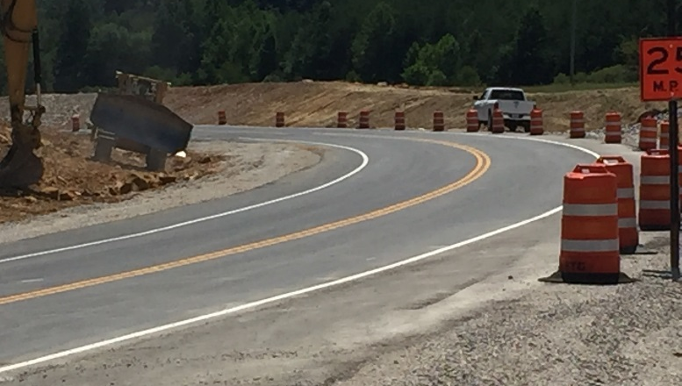
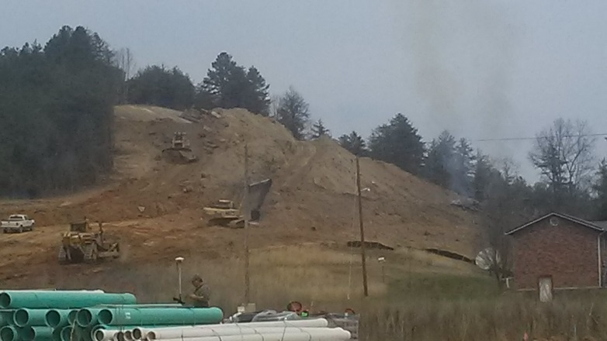
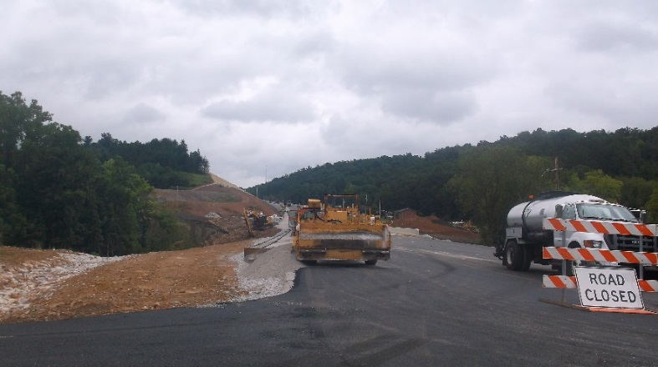
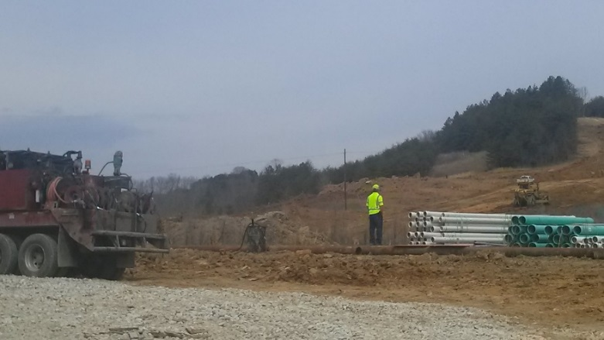
CONSTRUCTION
10-1084.00

Slide 8
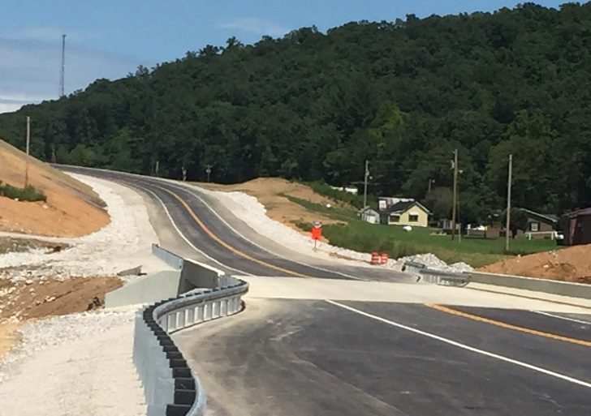

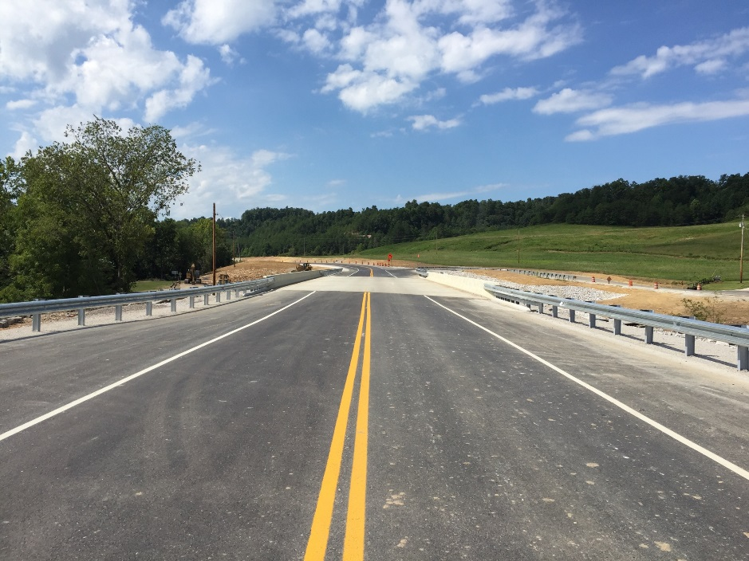
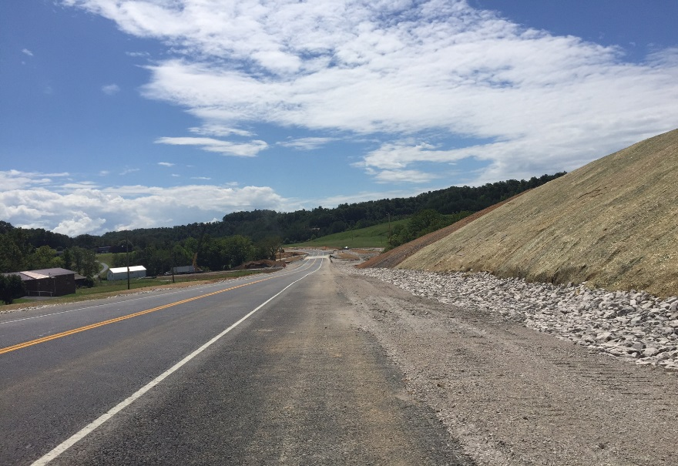
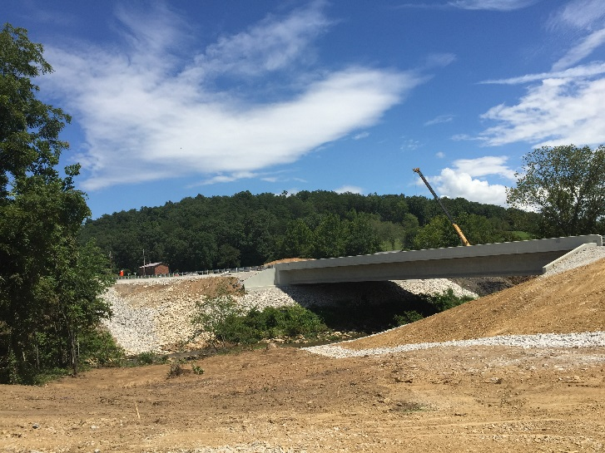
Thank you
10-1084.00

Slide 9
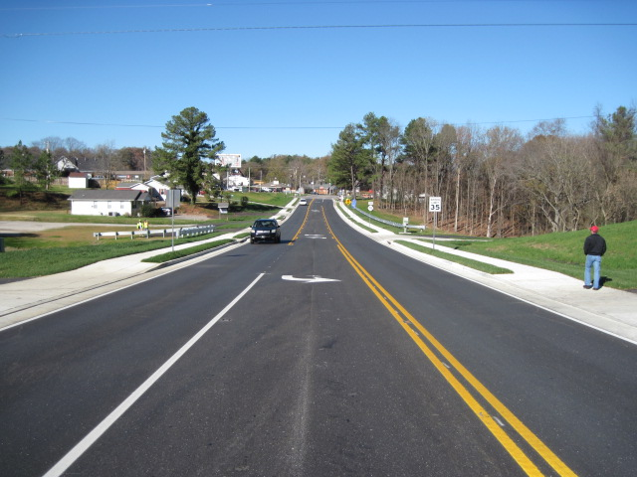
US 231, BUTLER COUNTY

Slide 10
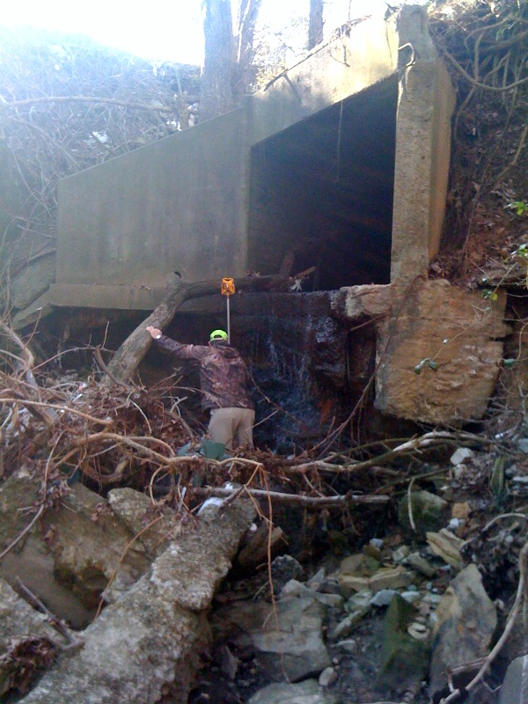
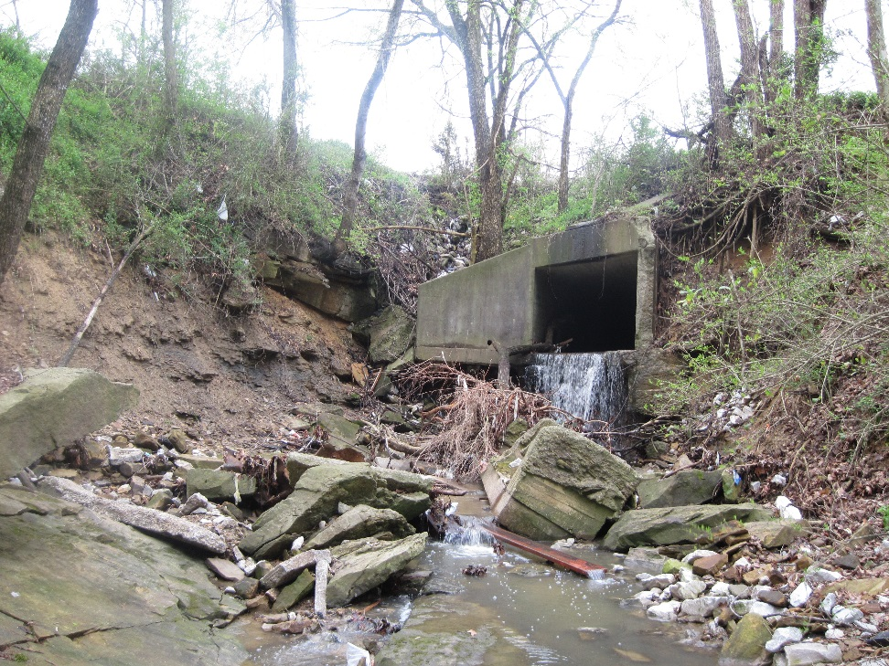
EXISTING 8’ X 6’ BOX CULVERT
EXISTING OUTLET

Slide 11
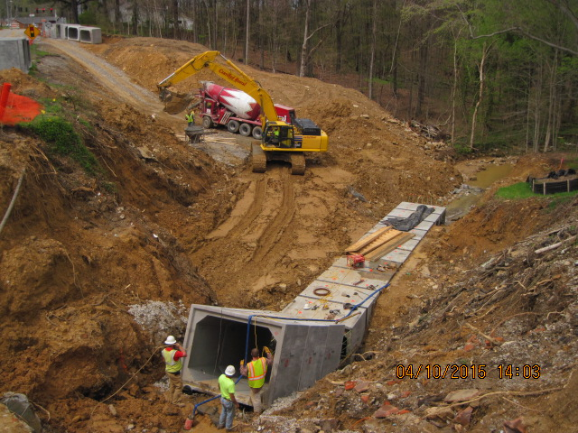
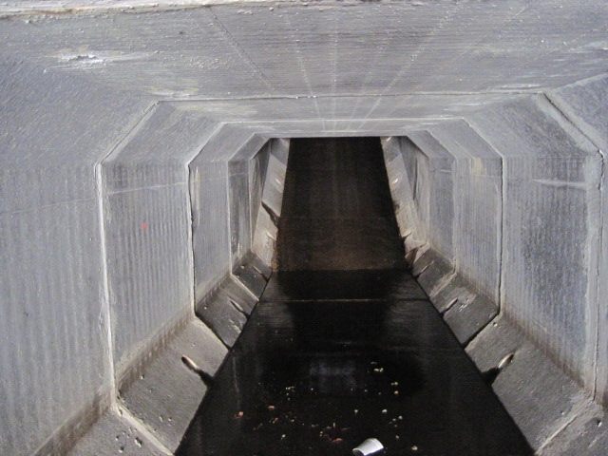
PROPOSED 8’ X 6’ BROKEN BACK BOX CULVERT
2:1 broken back box culvert
Outlet (looking up stream)

Slide 12
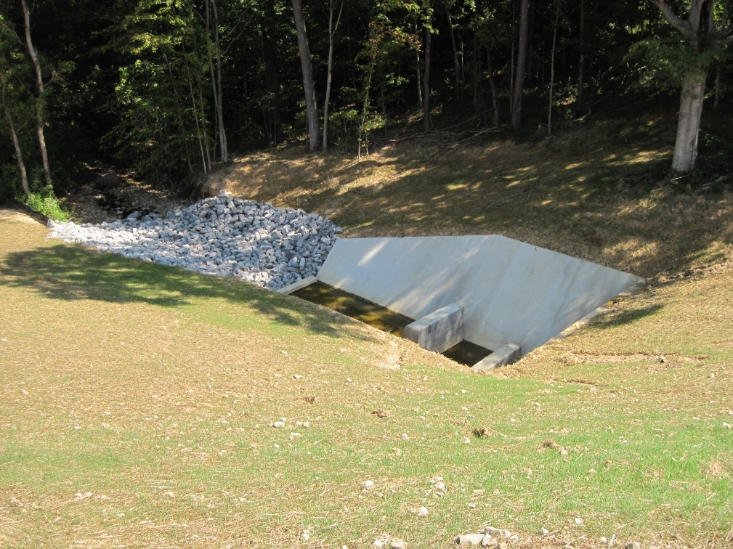
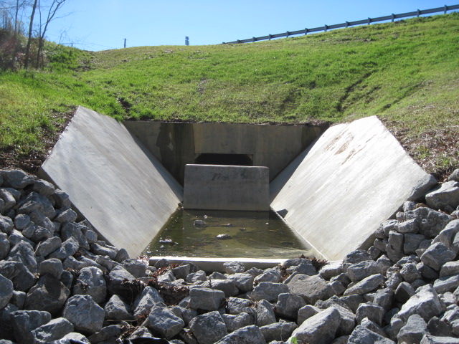
8’ X 6’ BOX CULVERT
CONTRA COSTA ENERGY DISSIPATER

Slide 13
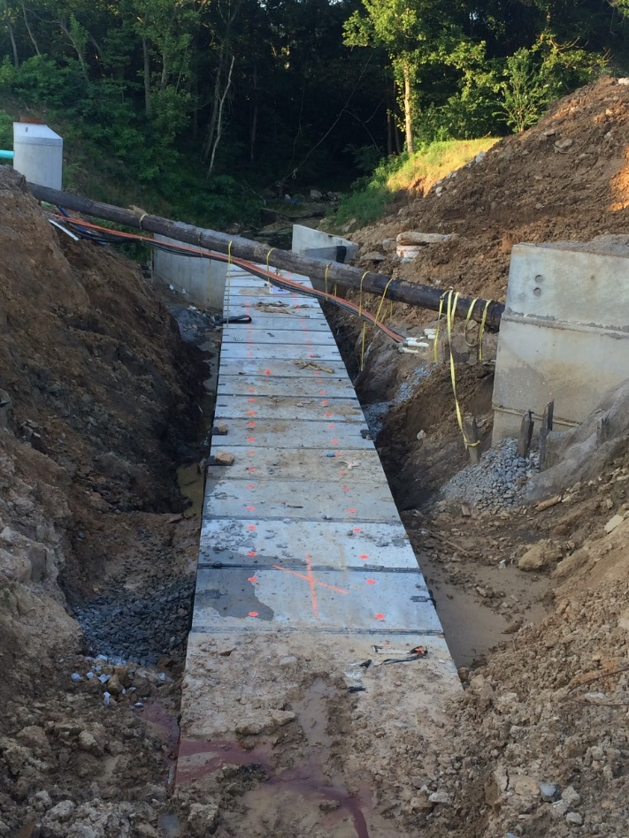
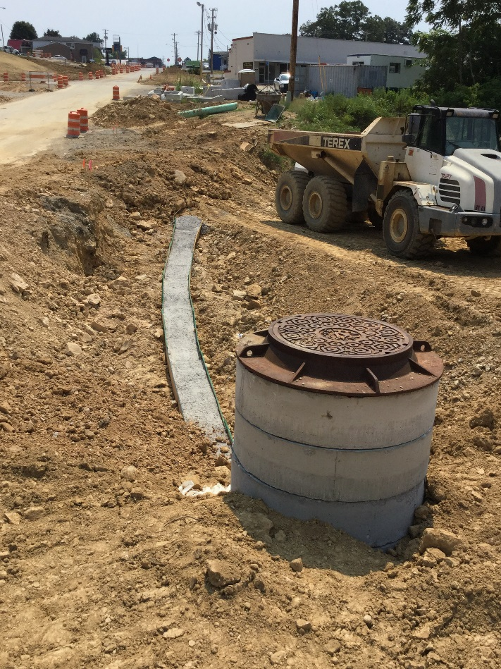
UTILITY COORDINATION
FIBER OPTIC LINE SUPPORTED DURING CONSTRUCTION
FIBER OPTIC LINE CONCRETE DUCT RE-CONSTRUCTED

Slide 14
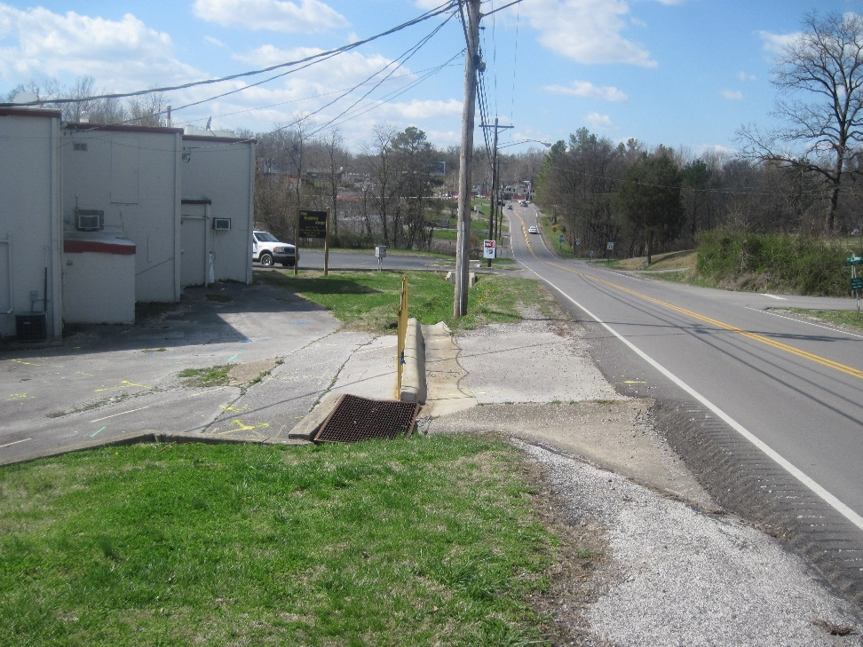
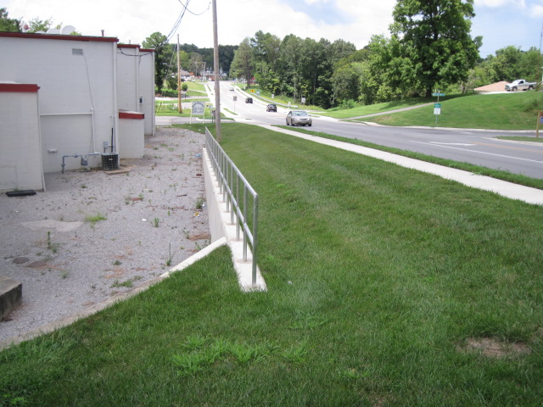
RETAINING WALL
BEFORE
AFTER

Slide 15
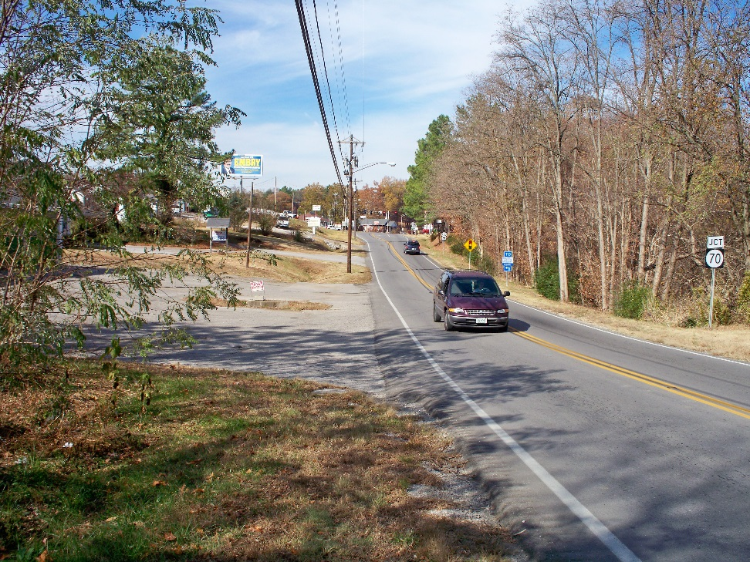

US 231 LOOKING NORTH
BEFORE
AFTER

Slide 16
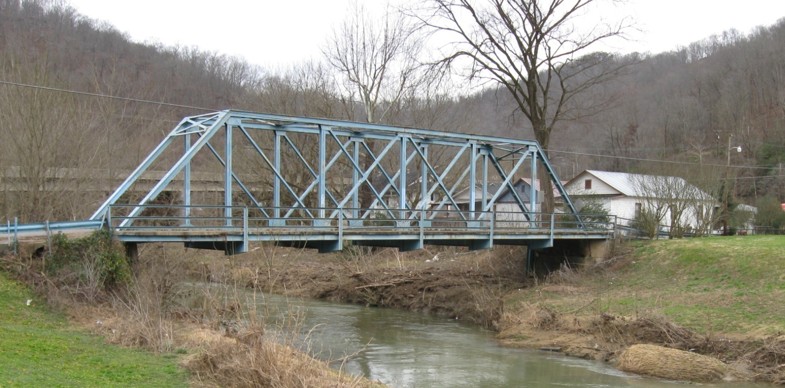
12-1085
KY 777 Bridge Replacement at Garrett
Floyd County
Notes:
Lastly is a District 12 project submitted by Chris James.

Slide 17
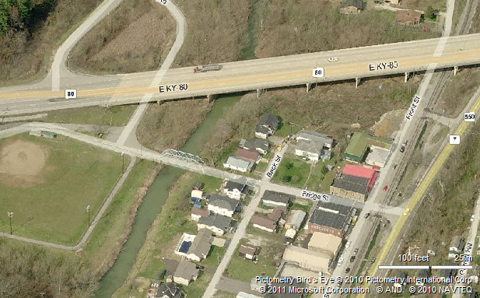
Project Location
To Prestonsburg
KY 80
Project Location
Notes:
One of the most interested aspects of this submittal is the narrative from a Bridge’s point of view.
The bridge gave it’s autobiography, mentioning that it was bypassed so to speak when KY -80 was reconstructed in the late 1970’s.

Slide 18

Existing Conditions
One-Lane Steel Truss Bridge
  Approx. 11.5’ wide with 3.5’ sidewalk
  Single Span (approx. 100’)
  Opening Area = 1,471 sq. ft.
  Sufficiency Rating = 3
  Built in 1944
    Eligible for National Register of Historic Places
Approx. 16’-18’ wide approaches
ADT
  2008: 640
  2028: 800
Notes:
Bridge was still used to primarily access the old high school which later relocated a few miles away as Allen Central and the old building was demolished. There was consideration of removing the bridge completely. Through public outcry via Facebook and the need to provide alternate access to baseball field, walking track, and picnic shelters it was decided to keep the crossing.

Slide 19
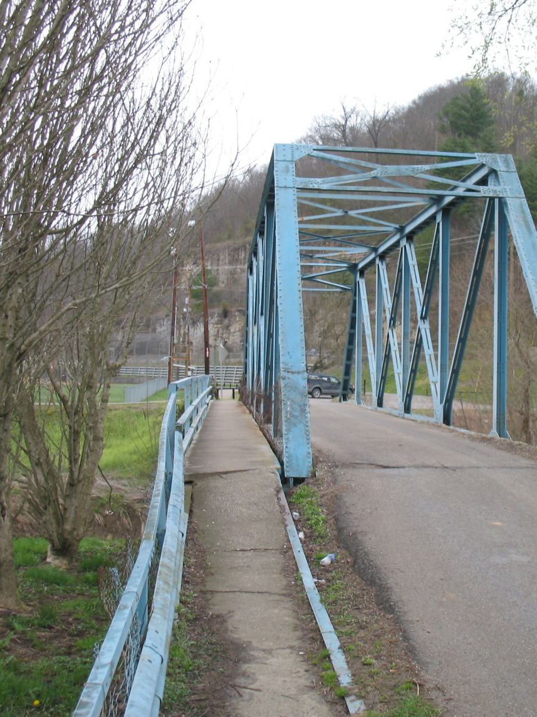
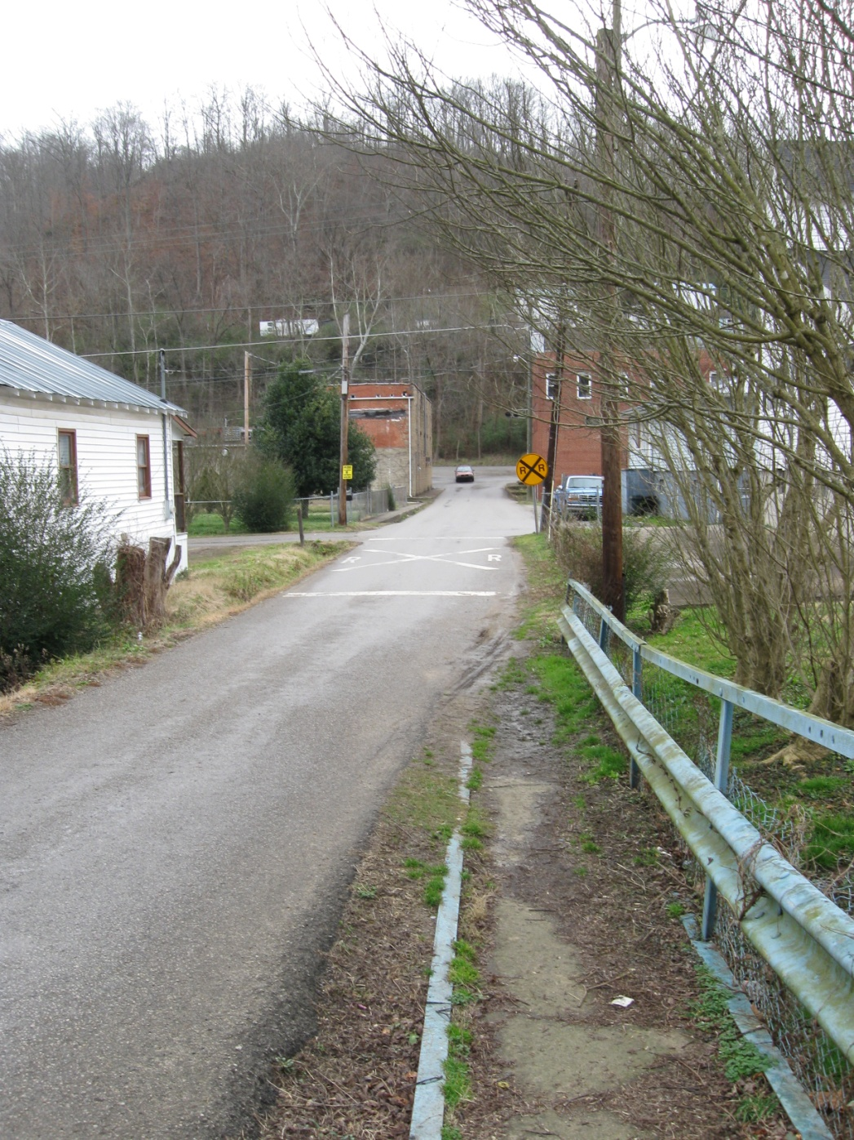
Notes:
Connection from downtown Garrett to park.

Slide 20
Alternates
 | Right of Way | Utilities | Construction | TOTAL
Alternate 1 – Repair Existing | $48,500 | $35,000 | $730,400 | $813,900
Alternate 2 – Spread Box Beam Bridge | $159,700 | $45,000 | $643,617 | $848,317
Alternate 3 – Thru-Girder Bridge | $152,200 | $40,000 | $898,216 | $1,090,416
Alternate 4 – Truss Bridge | $152,200 | $40,000 | $1,068,301 | $1,260,501
Alt. 1-Preferred
Low traffic volumes utilizing the bridge
Emphasis to preserve truss bridges
Based on structural inspection, relatively good condition of truss
Lowest project cost of all alternates
Notes:
Alts considered.

Slide 21
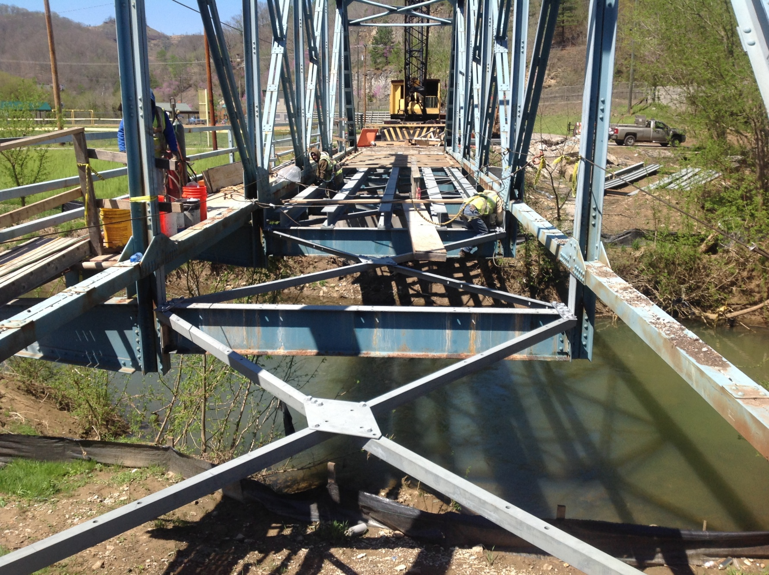
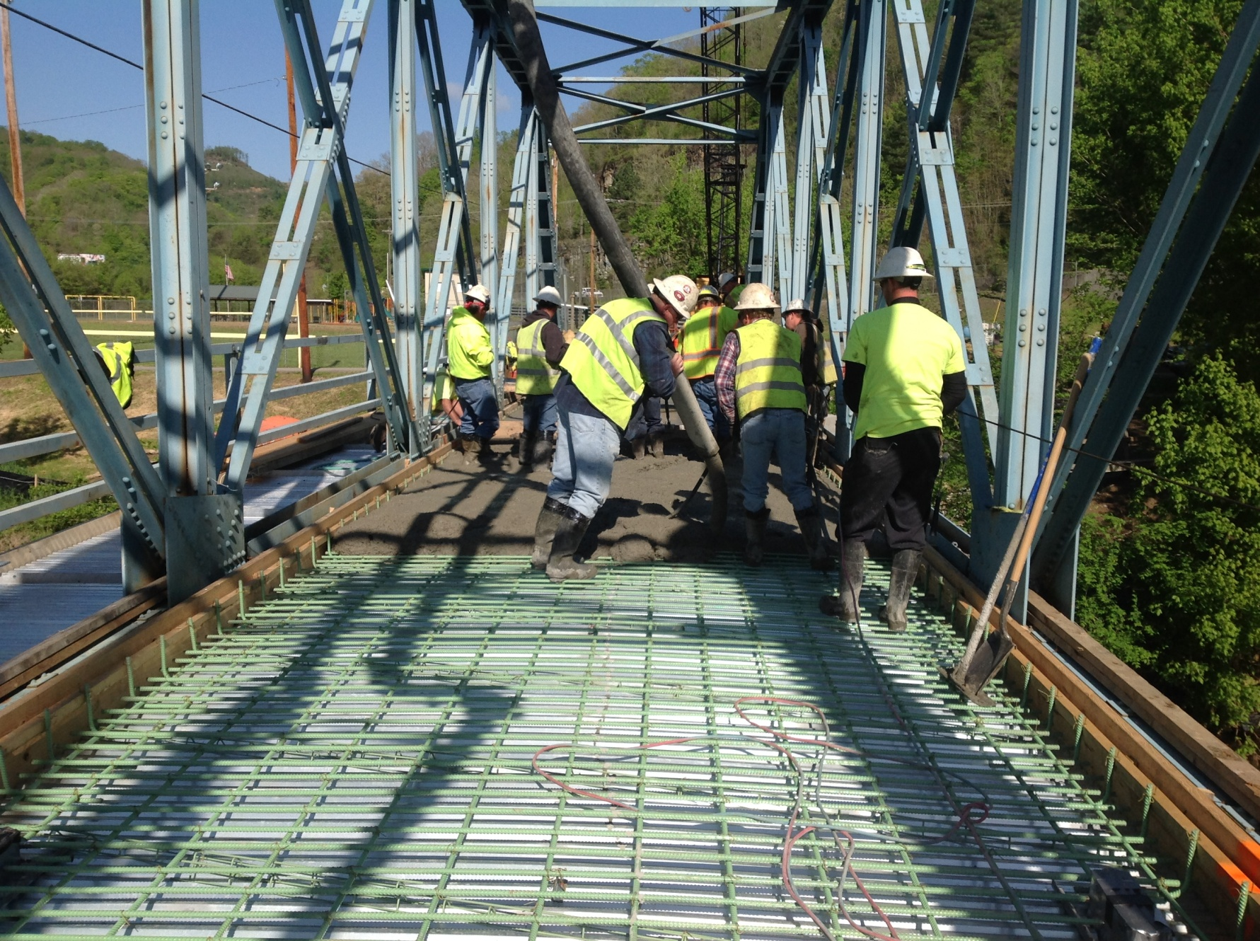
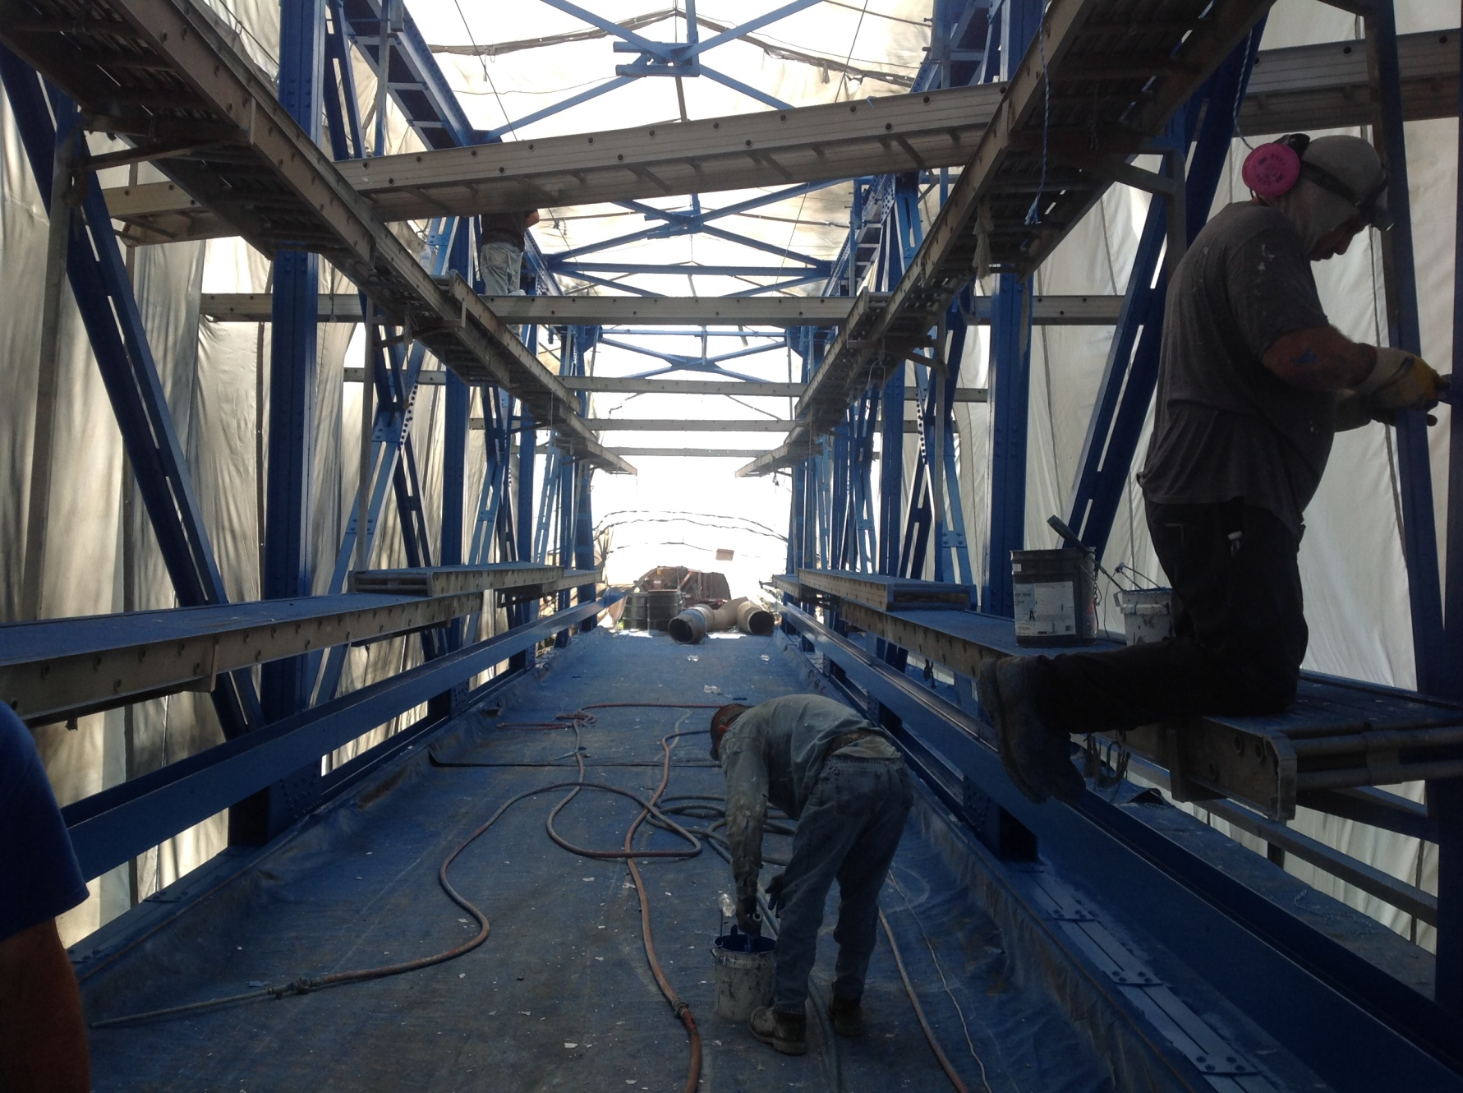
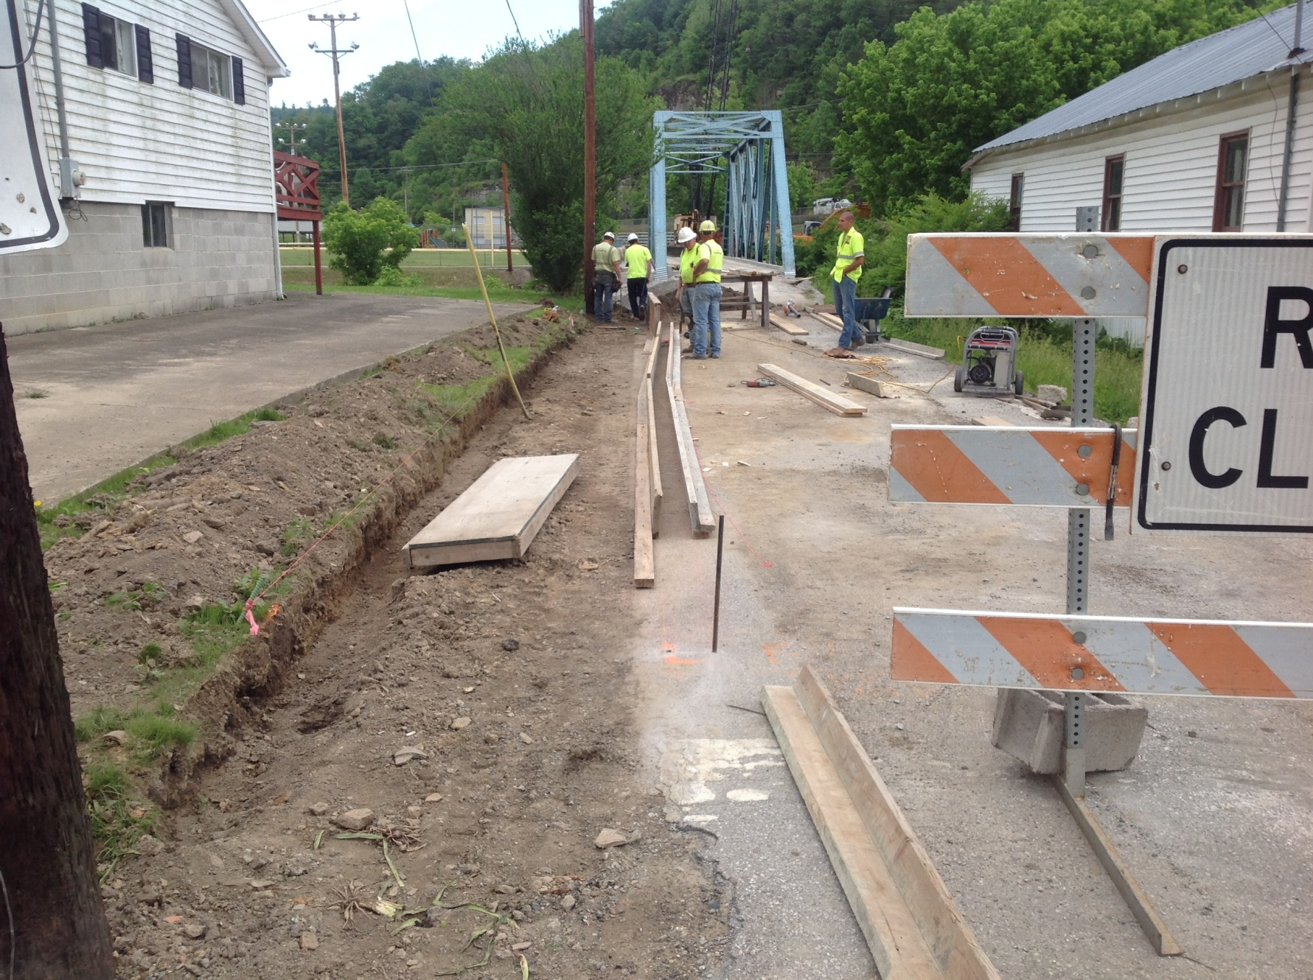
Deck Removal
Deck Reconstruction
Paint Process
Approach Work
Notes:
Bridge received a new deck.

Slide 22
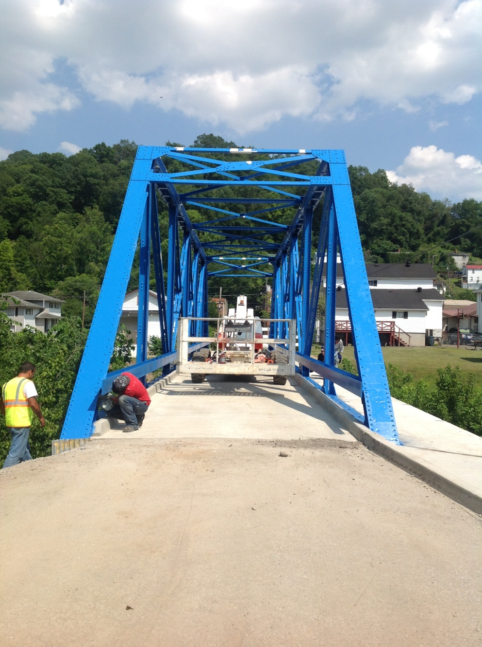
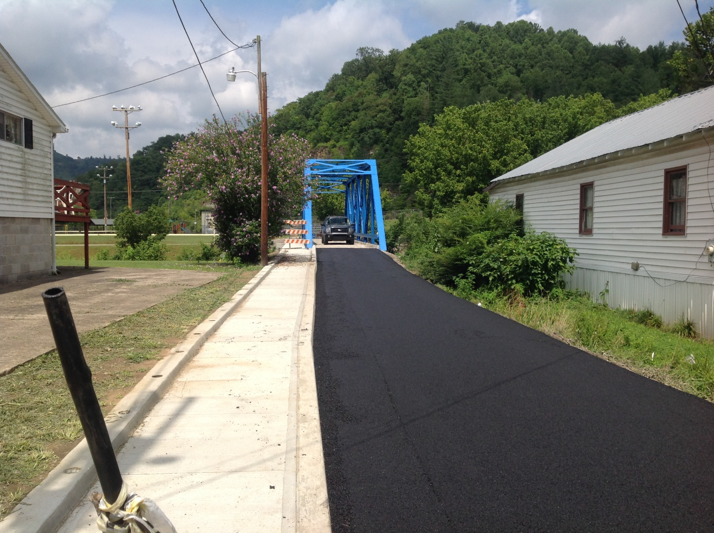
Approach Work
Nearly Completed
Notes:
Interesting is that the bridge was going to be orange to which the bridge responded “What is this, Tennessee?” Orange was the school color of the old Garrett High school.

Slide 23
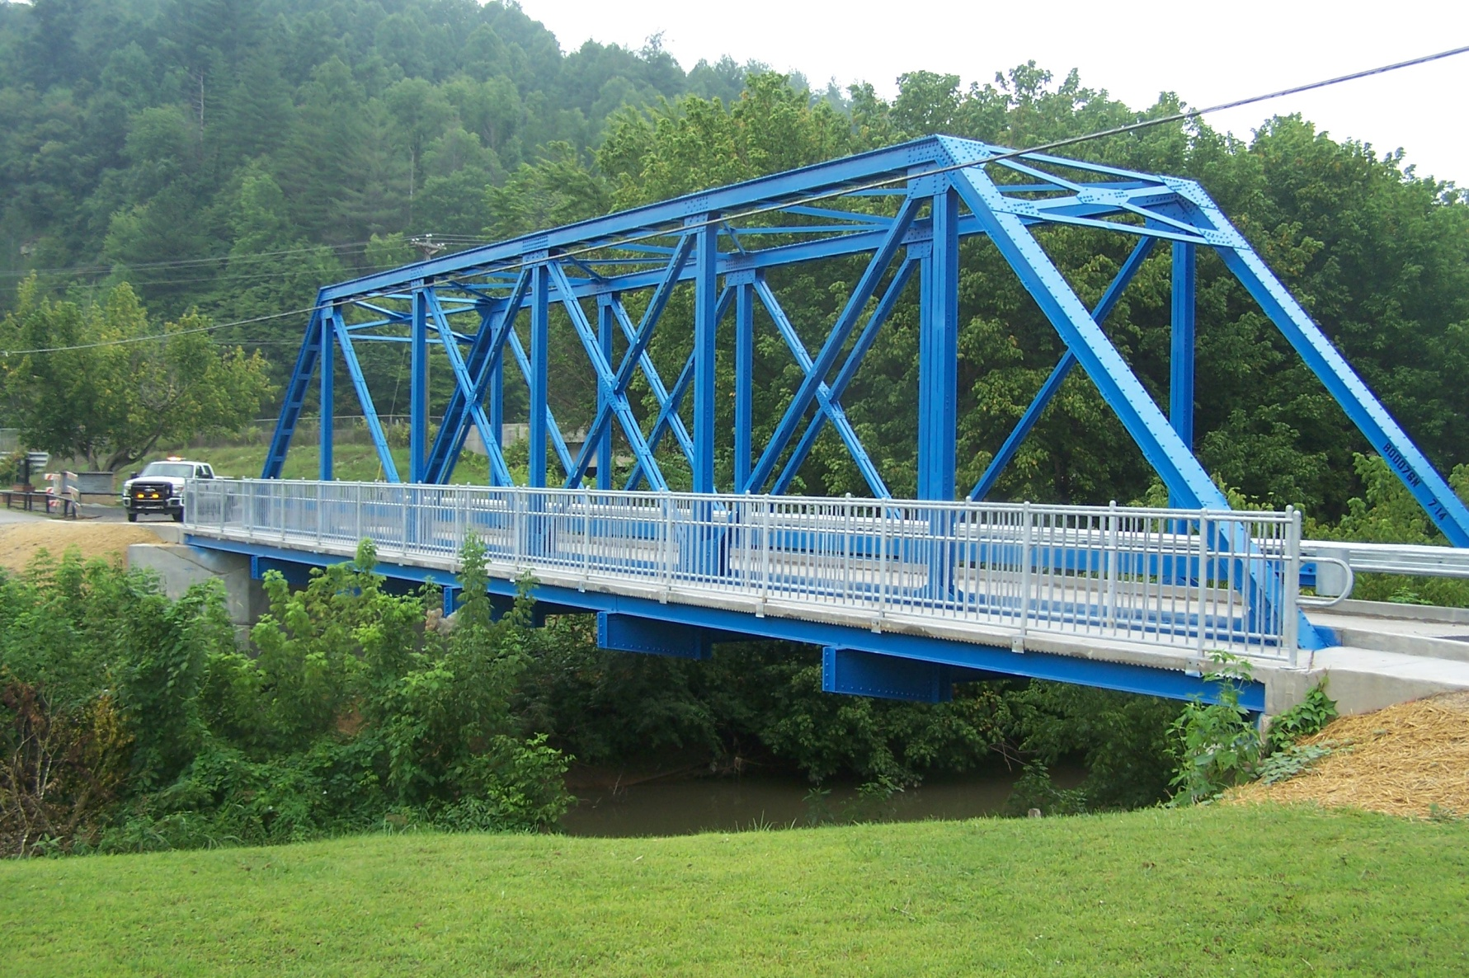
Finished Bridge
Notes:
Fortunately contract could not obtain this color as specified in the contract so became a brighter blue version of the previous version. A great story and another great project. Now for this years recipient of the 2015 Project Excellence Awards………

Slide 24
District 5
Item 5-371.12
Jefferson County
Springcrest Drive
Culvert Replacement

Slide 25
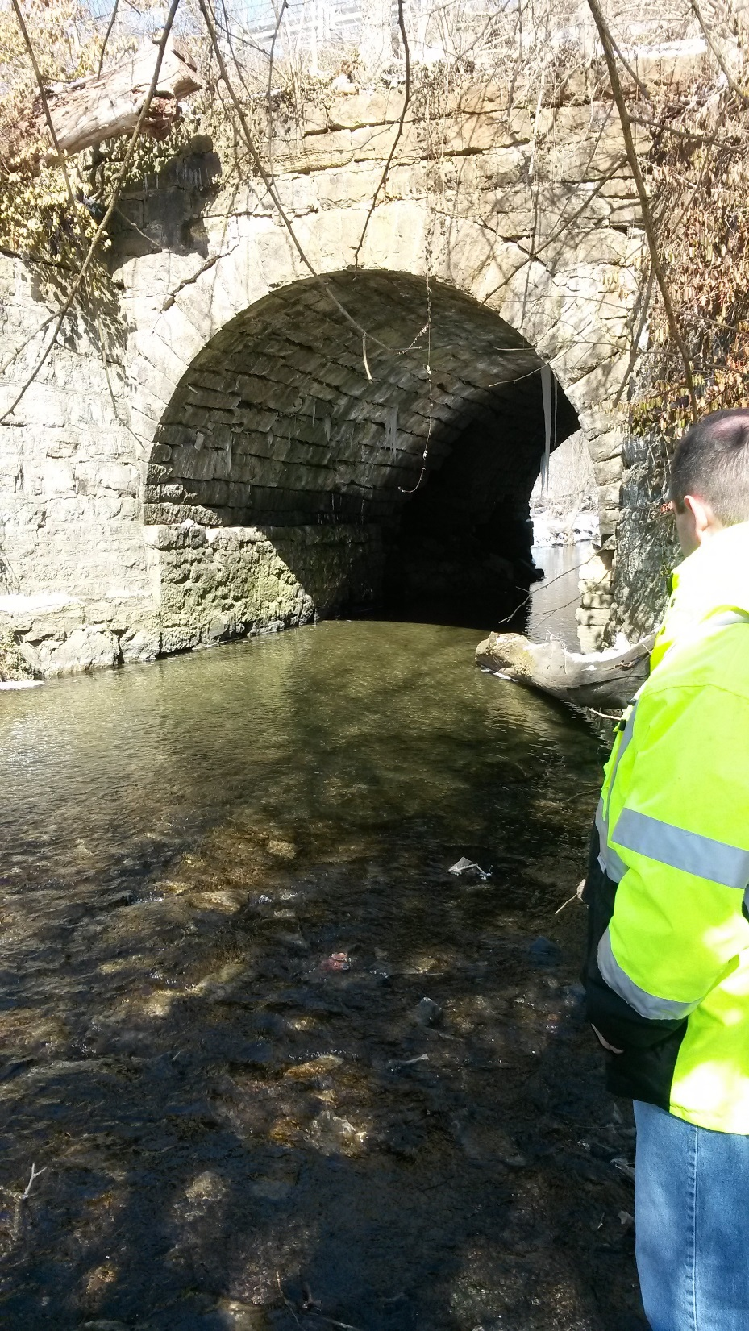
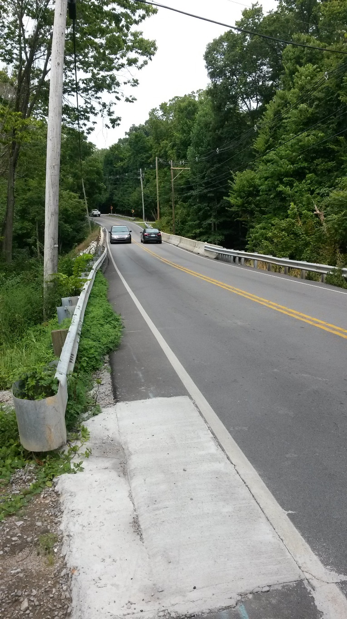

Slide 26
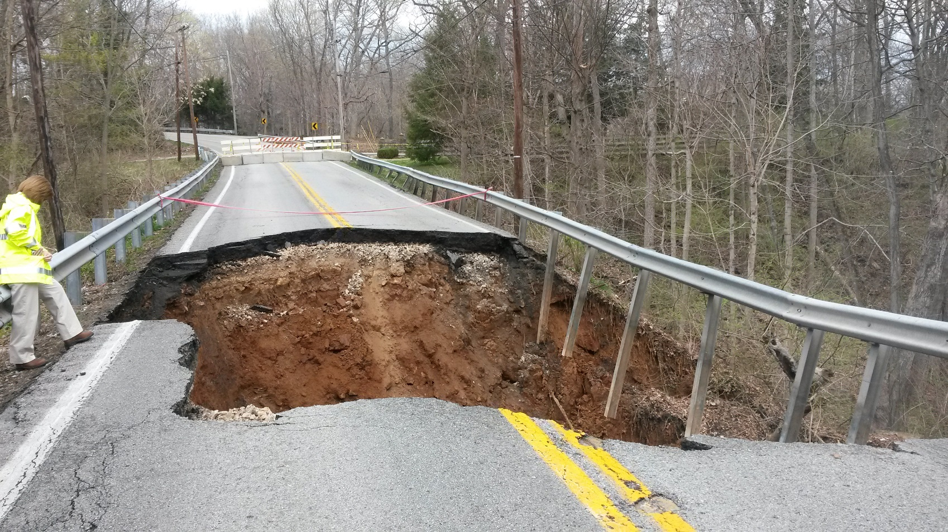

Slide 27
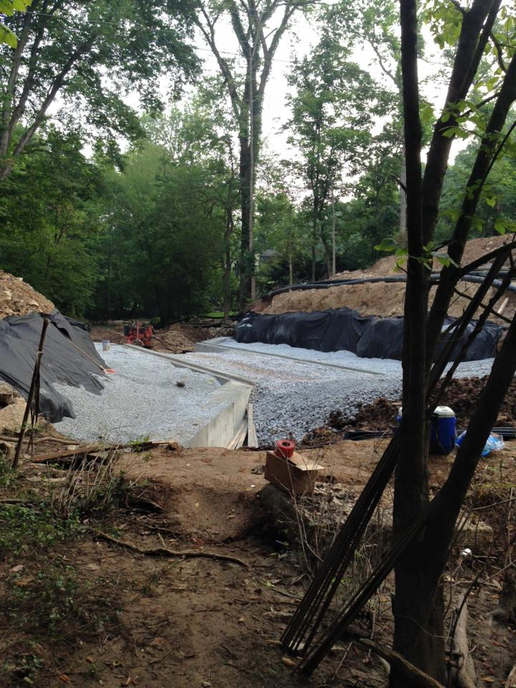
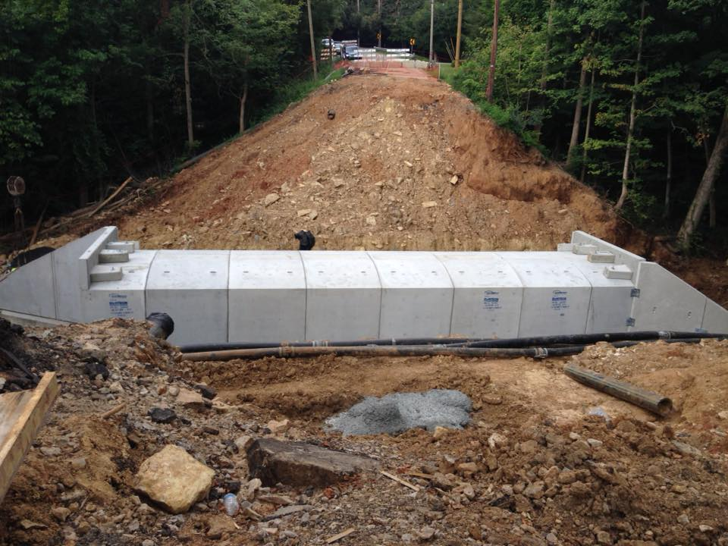

Slide 28
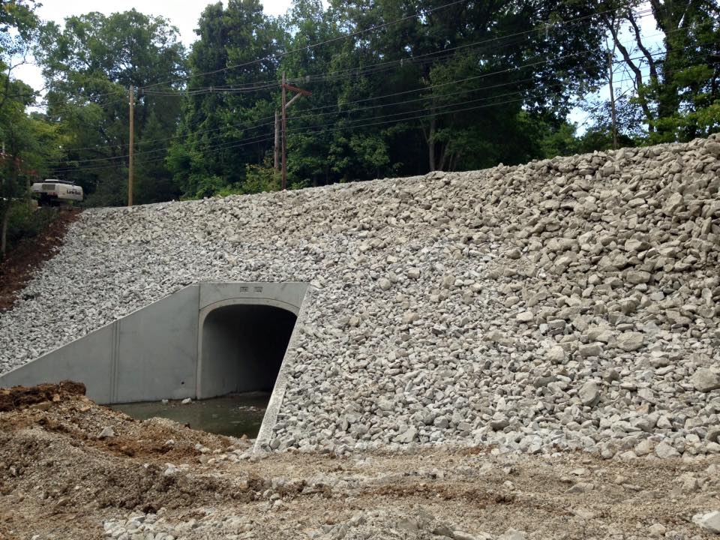
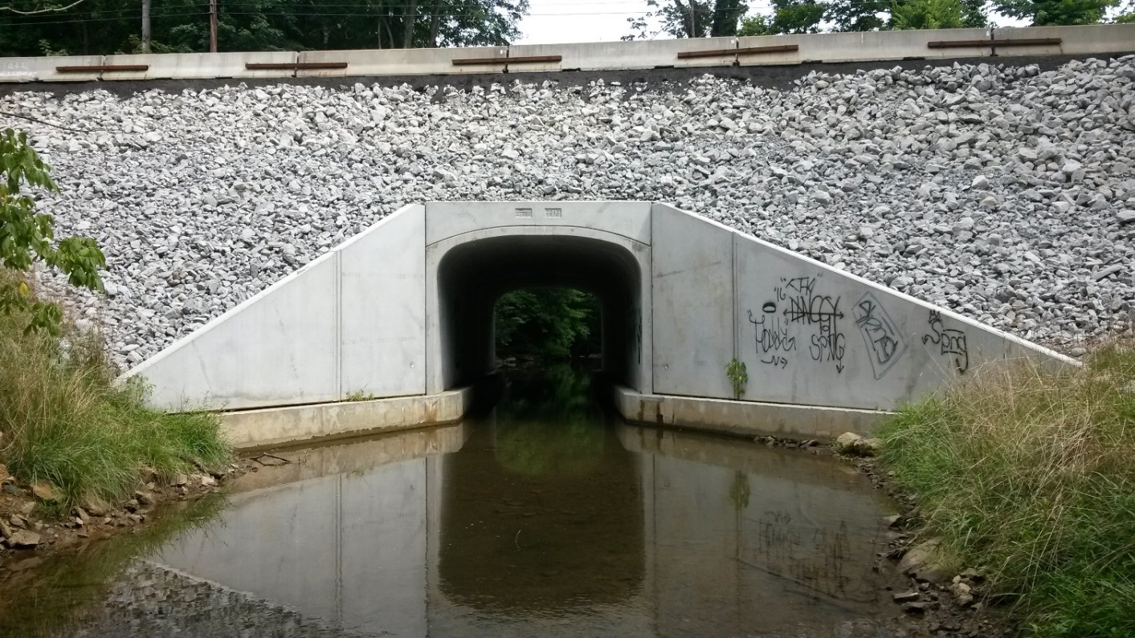

Slide 29
The 2016
William S. Gulick
Project Excellence Award goes to …???

